Slide 1
Credit card faurd detection
Using python

Slide 2
Topic: Credit Card Fraud Detection
Phase 1: problem definition and design thinking Problem Definition:
The problem of credit card fraud detection involves identifying and preventing unauthorized or fraudulent transactions made using credit or debit cards. It is crucial to protect cardholders and financial institutions from financial losses and maintain the integrity of the payment system.
Understanding the problem
Credit card fraud poses significant risks and challenges to various stakeholders, including:
Cardholders: They can experience financial losses, inconvenience, and potential damage to their
Merchiants: They may face chargebacks, financial losses, and reputational damage.
•
•
transactions and are keen to minimize losses.
•
Financal Institutions: They are responsible for reimbursing cardholders for fraudulent
•
Payment Networks (e.g., Visa, MasterCard): They have a vested interest in maintaining the
integrity and security of their payment systems.
Design thinking
Empathize:
Understand the needs, pain points, and perspectives of all stakeholders involved, including cardholders, merchants, financial institutions, and fraud analysts.
Conduct interviews, surveys, and observations to gather insights into their experiences with fraud detection and their concerns.
Define:
Clearly articulate the problem by synthesizing the information collected during the empathy phase.
Develop a problem statement that focuses on the challenges faced by stakeholders and defines the goals of the fraud detection system.
Ideate:
Generate a wide range of creative ideas for addressing the problem. Encourage brainstorming sessions with cross-functional teams.
Explore both technological and non-technological solutions, considering process improvements, user education, and new technologies.
Prototype:
Create prototypes or mock-ups of potential solutions. This could include user interfaces, algorithmic models, or process flowcharts.

Slide 3
Develop a working prototype of a fraud detection algorithm or system to test its feasibility and functionality.
Test:
Gather feedback on your prototypes and test the proposed solutions with actual users and stakeholders.
Evaluate the effectiveness of different fraud detection methods and algorithms using historical data or simulated scenarios.
Make necessary adjustments based on user feedback and test results.
Implement:
Develop a detailed plan for implementing the chosen fraud detection solution.
Collaborate with technical teams to integrate the system into existing infrastructure, ensuring scalability and real-time capabilities.
Measure and Monitor:
Define key performance indicators (KPIs) to measure the success of the fraud detection system. Common KPIs include detection rate, false positive rate, and financial impact.
Continuously monitor the system's performance, collect relevant data, and analyze results to identify areas for improvement.
Iterate:
Use insights from measurements and monitoring to drive iterative improvements to the fraud detection system.
Adapt to emerging fraud patterns and changing user needs by regularly revisiting the design and implementation.
User Experience (UX) and Ethics:
Prioritize a positive user experience for both cardholders and internal users. Ensure that fraud alerts and actions are clear and user-friendly.
Uphold ethical principles by safeguarding cardholders' data privacy and adhering to industry regulations and legal standards.
Collaboration:
Foster collaboration among diverse teams, including data scientists, engineers, UX designers, compliance experts, and domain specialists.
Encourage cross-functional communication and teamwork to ensure a holistic approach to fraud detection.
By applying design thinking principles to credit card fraud detection, you can create solutions that not only effectively combat fraud but also enhance the user experience, consider ethical and regulatory concerns, and adapt to the evolving nature of financial fraud. This iterative and user-centric approach can lead to more robust and innovative fraud prevention systems.

Slide 4
Accuracy:
The accuracy of the model on the test data (in this case
approximately 94.5%).
Confusion Matrix:
A table showing the number of true positives
true negatives
false positives
false negatives
it indicates that there were
91 true negatives
5 false positives
6 false negatives
98 true positives.
Classification Report: This report provides precision
recall
F1-score
support for each class (0 and 1) along with their weighted averages
macro averages.

Slide 5
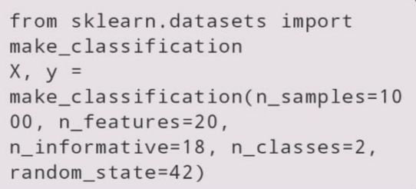
GENERATE SAMPLE DATASET
This code generates a synthetic dataset using `
make_classification` from Scikit-Learn. It creates 1000 samples with 20 features, where 18 features are informative. The dataset is binary classification with two classes.

Slide 6
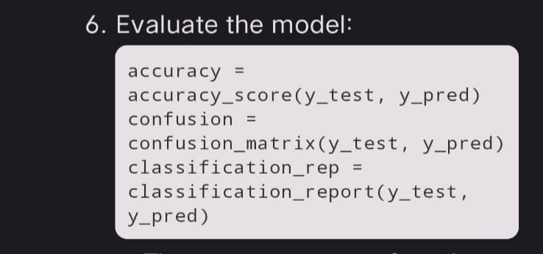
EVALUATE THE MODEL:
- The `accuracy_score` function calculates the accuracy of the model's predictions on the test set.
- The `confusion_matrix` function generates a confusion matrix, which provides information about true positives, true negatives, false positives, and false negatives.
- The `classification_report` function generates a report with precision, recall, F1-score, and support for each class.

Slide 7
Machine learning algorithm :
It imports necessary libraries, including NumPy, pandas,
and scikit-learn (a popular machine learning library in Python).
It generates a sample dataset using the make_classification function from scikit-learn.
This dataset has 1000 samples, 20 features, 18 informative features, and 2 classes. It's a synthetic dataset for binary classification.
A Logistic Regression model is created using LogisticRegression() from scikit-learn,
and it's trained on the training data using the fit method.
Predictions are made on the test set using the trained Logistic Regression model with the predict method.
The code then evaluates the model using the following metrics:
Accuracy: It calculates the accuracy of the model's predictions using accuracy_score.
Confusion Matrix: It generates a confusion matrix using confusion_matrix, which shows the true positives, true negatives, false positives, and false negatives.
Classification Report: It prints a classification report using classification_report, which includes precision, recall, F1-score, and support for each class.
In summary, the code uses Logistic Regression for binary classification and assesses the model's performance using accuracy, a confusion matrix, and a classification report.

Slide 8
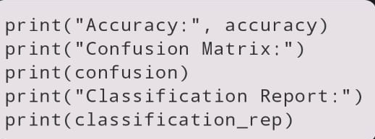
PRINT THE RESULTS :
Finally, the code prints the accuracy, confusion matrix, and classification report to evaluate the model's performance.
This code essentially demonstrates the process of training a simple logistic regression model for binary classification and evaluating its performance using standard machine learning metrics.

Slide 9
CODE :
# Import necessary libraries import numpy as np import pandas as pd from sklearn.model_selection import train_test_split from sklearn.linear_model import LogisticRegression from sklearn.metrics import classification_report, accuracy_score, confusion_matrix # Generate a sample dataset from sklearn.datasets import make_classification X, y = make_classification(n_samples=1000, n_features=20, n_informative=18, n_classes=2, random_state=42) # Split the dataset into training and testing sets X_train, X_test, y_train, y_test = train_test_split(X, y, test_size=0.2, random_state=42) # Train a Logistic Regression model model = LogisticRegression() model.fit(X_train, y_train) # Make predictions on the test set y_pred = model.predict(X_test) # Evaluate the model accuracy = accuracy_score(y_test, y_pred) confusion = confusion_matrix(y_test, y_pred) classification_rep = classification_report(y_test, y_pred) print("Accuracy:", accuracy) print("Confusion Matrix:") print(confusion) print("Classification Report:") print(classification_rep)

Slide 10
Explanation :
Step 1 : first open a visual studio.
Step 2 : create a folder as credit card faurd detection.
Step 3 : save the folder.
Step 4 : After save the folder and open a new file, select a language as python.
Step 5 : After select and save language , paste the code in text file.
Step 6 : once paste the code , need to download necessary packages.
Step 7 : once packages download completed.
Step 8 : Run the code will get result.
Step 9 : Exit

Slide 11

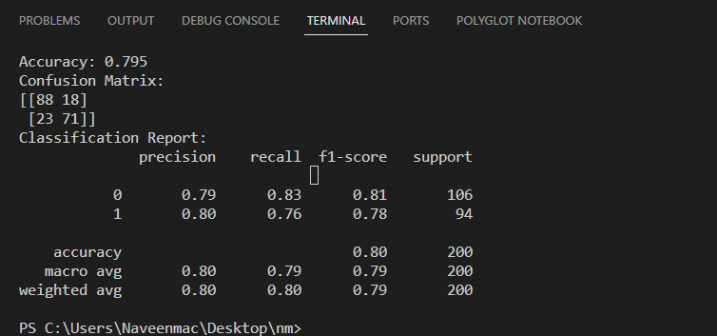
Output :

